Slide 1
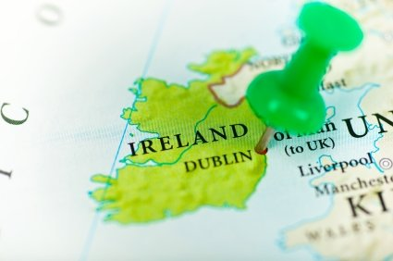

IReland

Slide 2
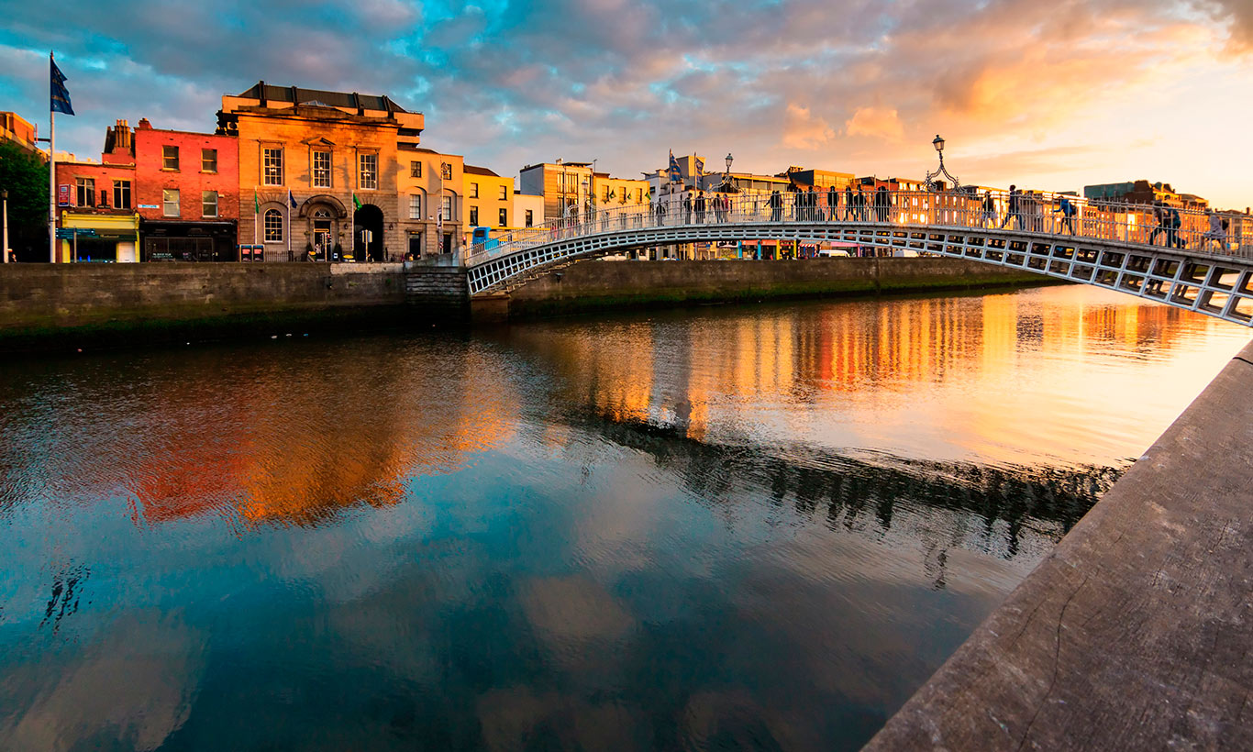
GEOGRAPHICAL LOCATION :
IRELAND is a country in Western Europe. It occupies most of the territory of the Island under the same name.
CAPITAL :
DUBLIN is a city located on the east coast of Ireland by the Irish Sea. The name derives from the Irish name „Dúbh Linn” – meaning black pond.

Slide 3
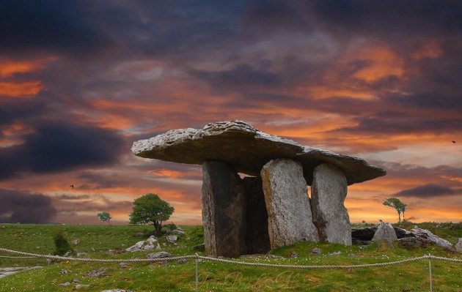
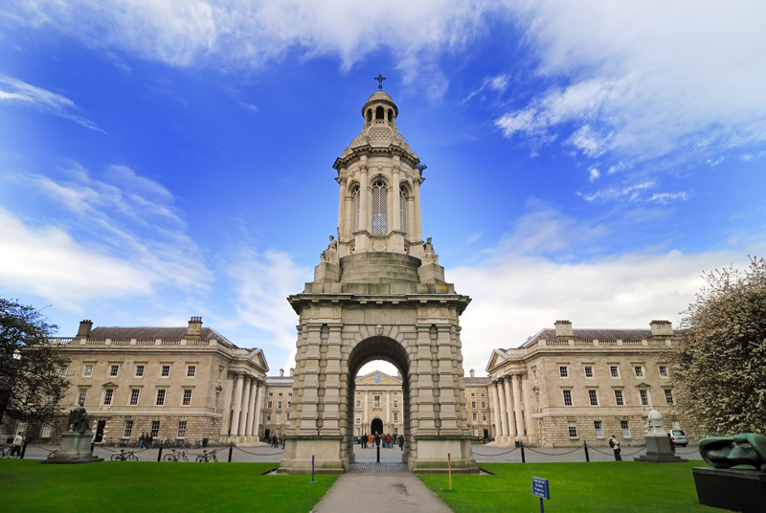
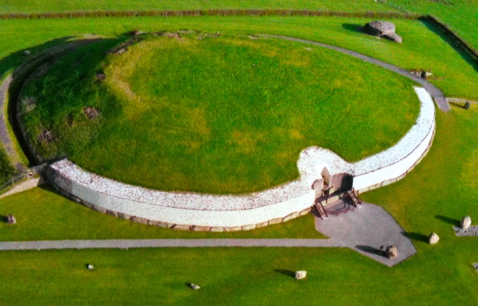
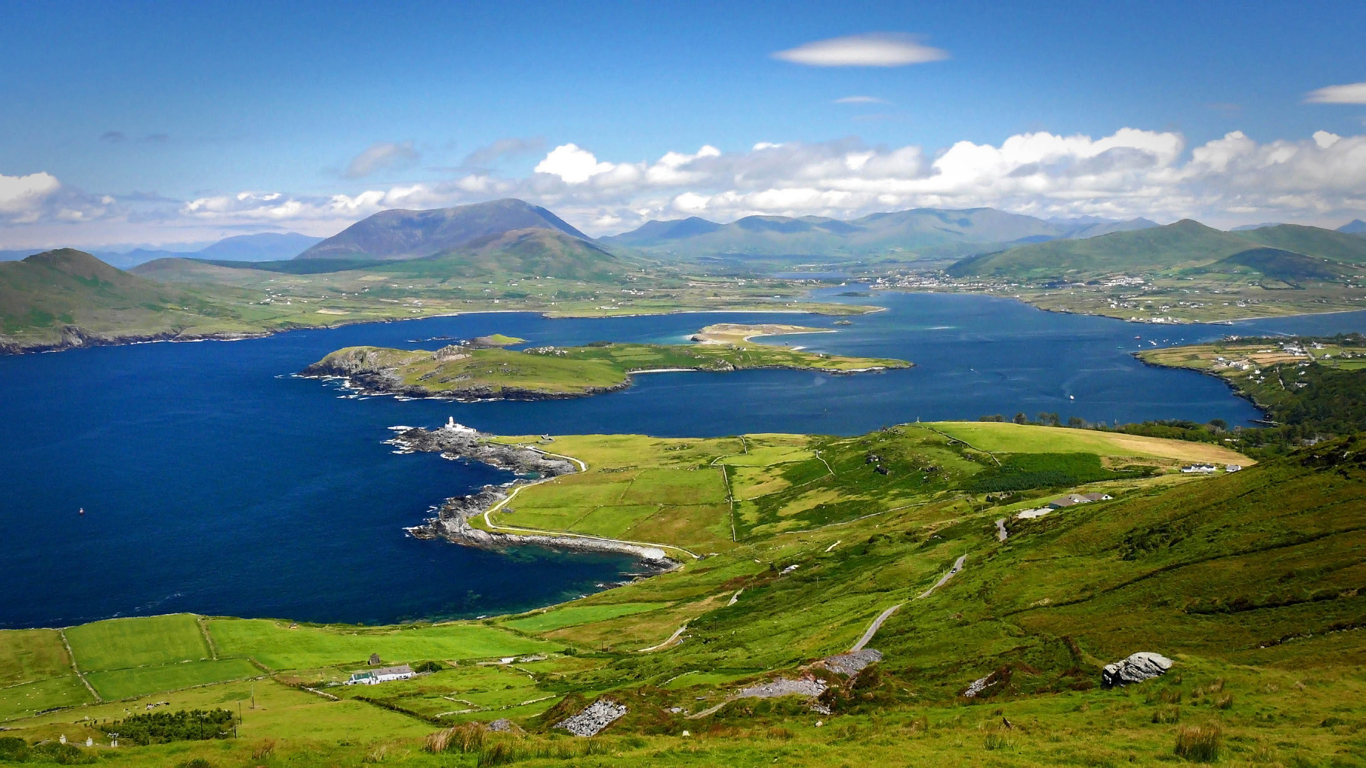
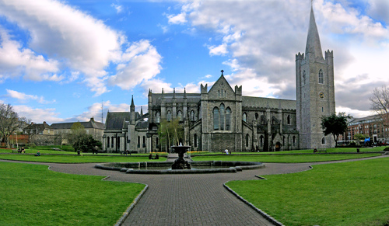
IMPORTANT PLACES AND MONUMENTS:
Burren- It is plateau created by karst limestone slabs. It contains rare species of flora and fauna.
Trinity College Dublin- It is a prestigious university on the islands, it is an impressive example of the Irish architecture.
Boyne Valley- These are big tombs built during ancient times. They are inscribed on the UNESCO list.
St.Patrick Catedral- It is the largest church in Ireland. There are buried such famous people as Jonathan Swift or the first president of Ireland Douglas Hyde.
Ring of Kerry- Beautiful scenic hiking trail running around the Iveragh in the Kerry County on the west coast of Ireland.

Slide 4
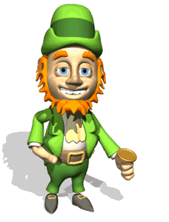
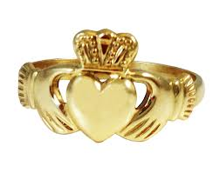
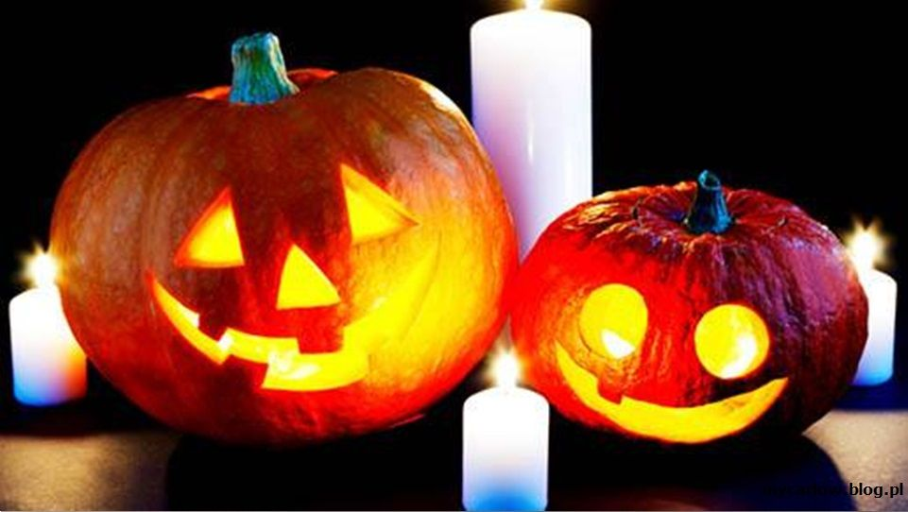
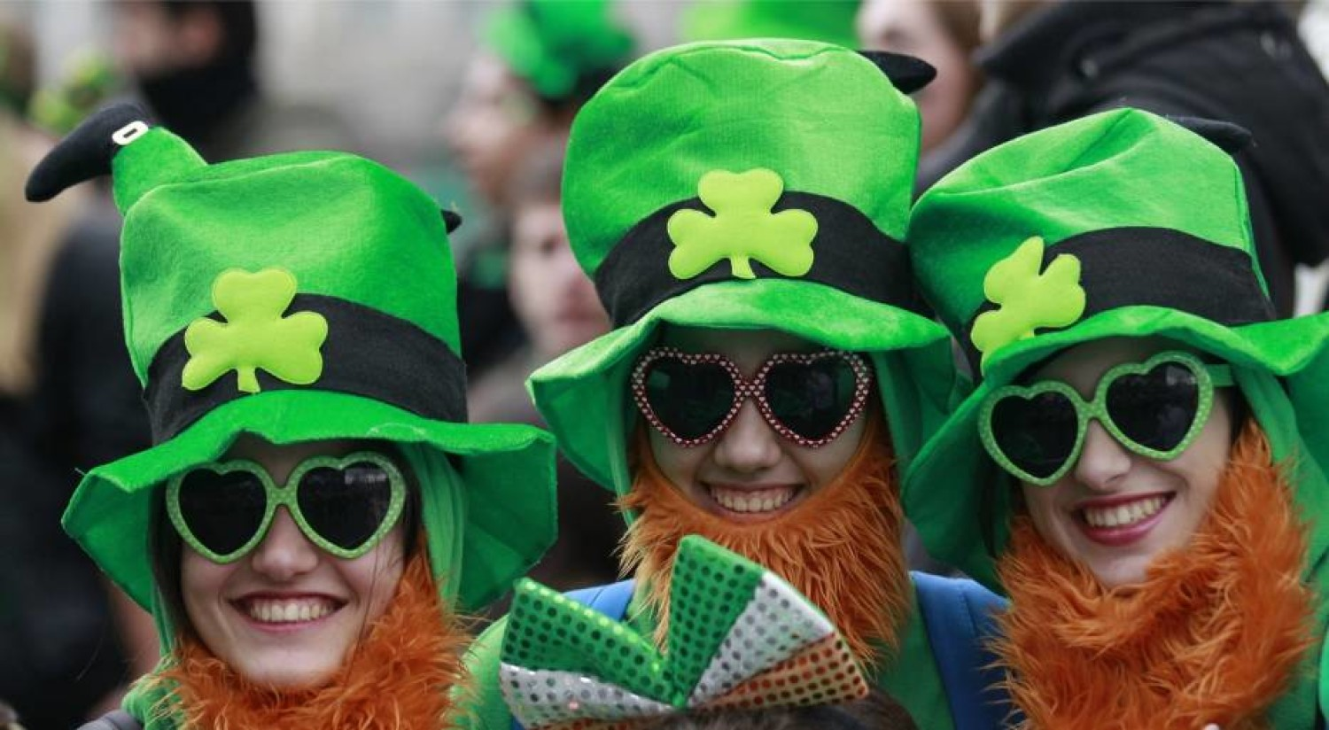
HOLIDAYS AND TRADITIONS:
Halloween (31st October) – The custom of celebrating Halloween originated in Ireland. It derives from the Celtic rite called Samhain (what means „end of the summer”).
Claddagh ring- A traditional Irish ring Which is given as a proof of friendship often given as an engagement ring or even a wedding ring.
St. Patrick's Day (17 March) – An important tradition of this holiday is wearing green clothes. Green is the national colour, referring to the island's landscape and symbolizes the four-leaf clover ascribed to st. Patrick.

Slide 5
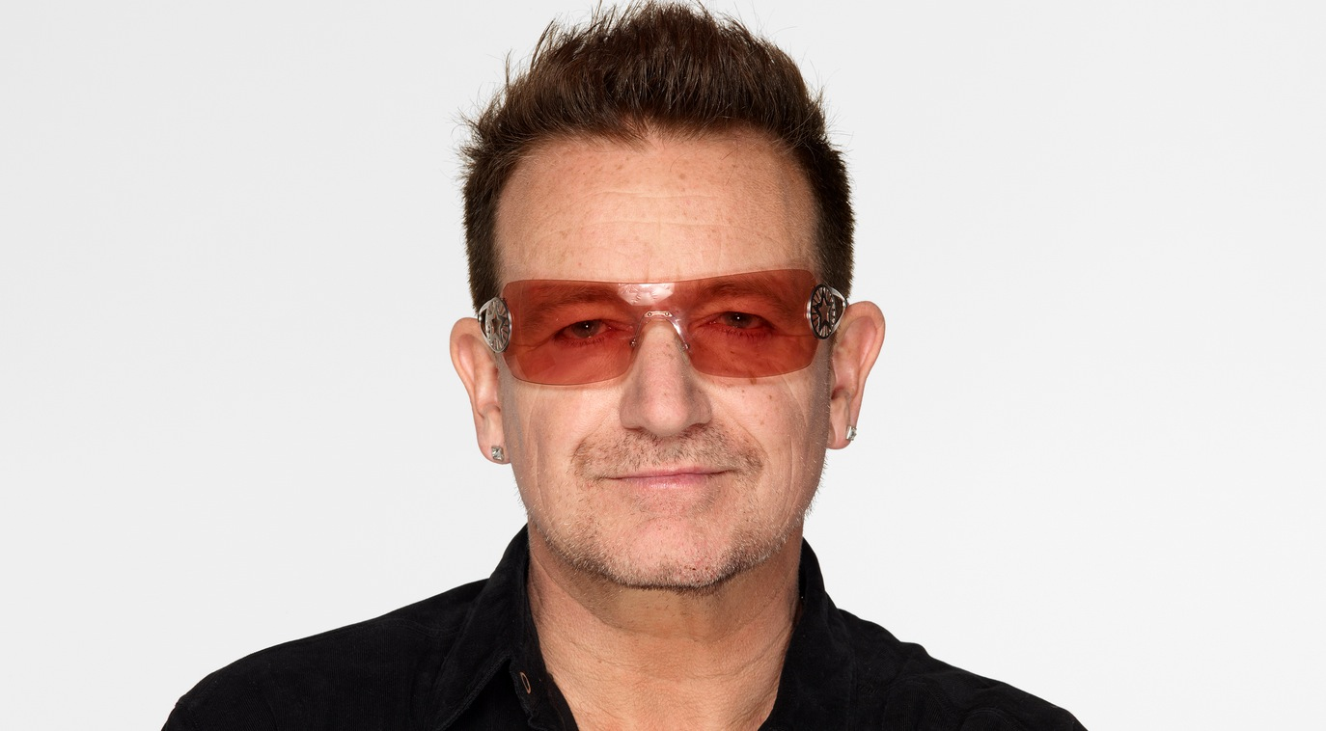
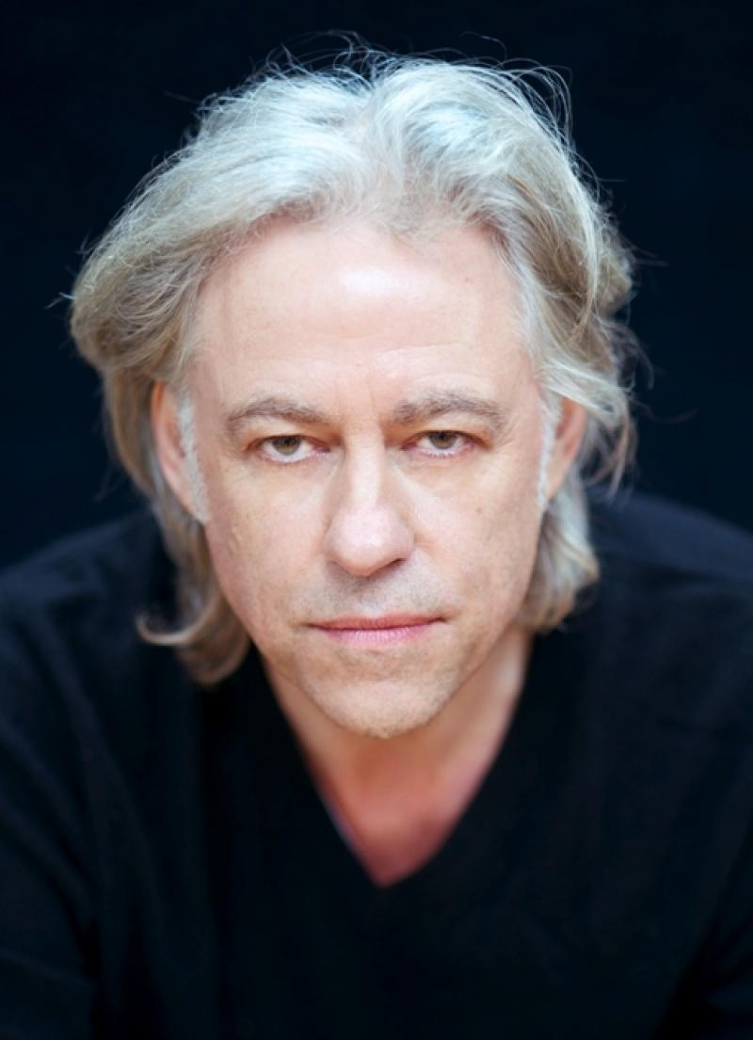
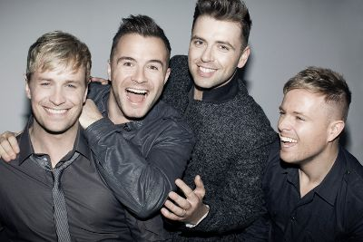
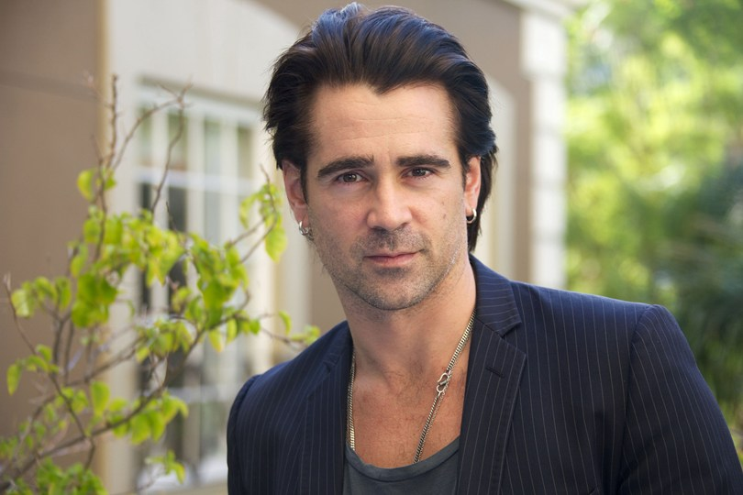
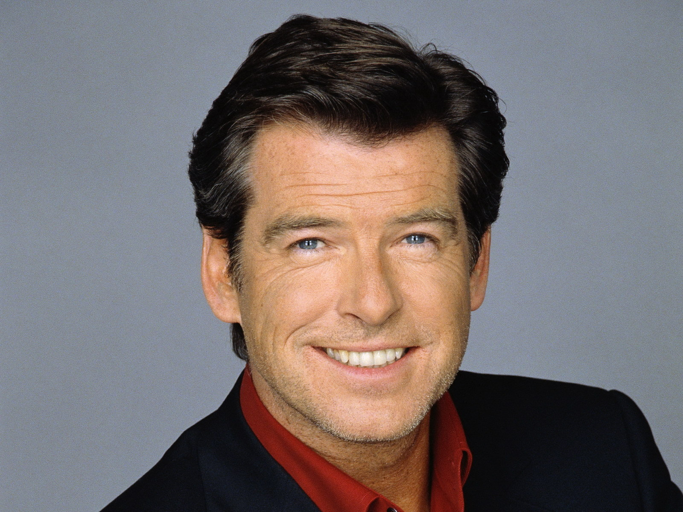
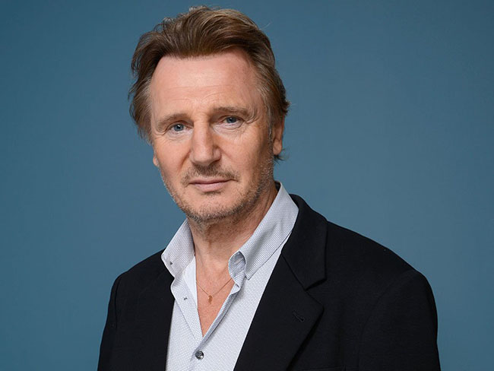
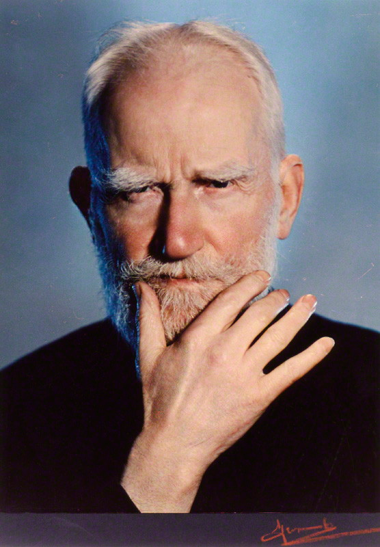
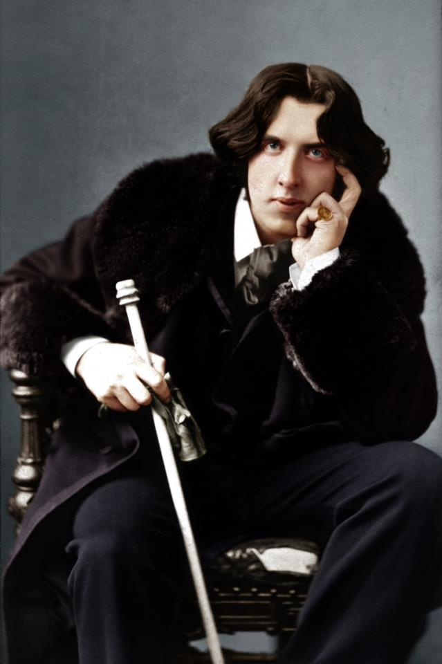
FAMOUS Irish PEOPLE:
Bono- (Paul David Hewson). He was born on 10th of May 1960 in Dublin. He is on Irish musician and the leader of the rock group U2.
Bob Geldof- (Robert Frederick Zenon Geldof). He was born on October 5, 1951 in Dublin. Irish singer, songwriter, actor, social activist and businessman.
Westlife- Irish boy band performing pop music, founded in 1998.
MUSIC
Pierce Brosnan- He is on Irish actor and film producer. He was born 16th May 1953 in Drogheda.
Liam Neeson – Northern Irish actor. He was born on 7th of June 1952 in Ballymen.
Colin Farrell- He was born on 31st of May 1976 in Dublin. He is on Irish actor.
FILM
George Bernard Shaw- (Born: 26th July 1856 in Dublin, died 2nd November 1950 in Ayot St Lawrence). Irish playwright, novelist, representative of realistic drama.
Oscar Wilde- (Born: 16th October 1854 in Dublin, died 30th November 1900 in Paris). Irish poet, novelist, playwright and classical philologist. The representative of modern aestheticism.
BOOK

Slide 6
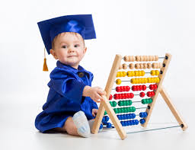
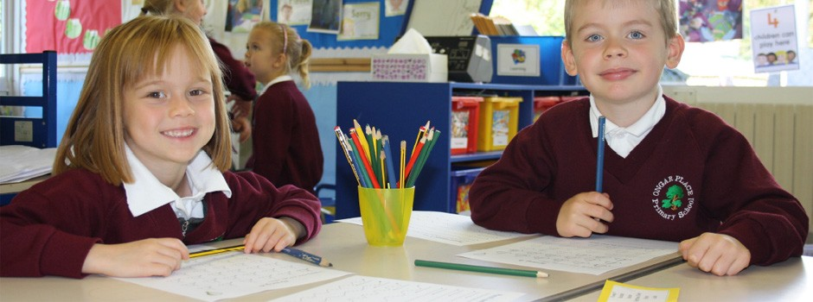
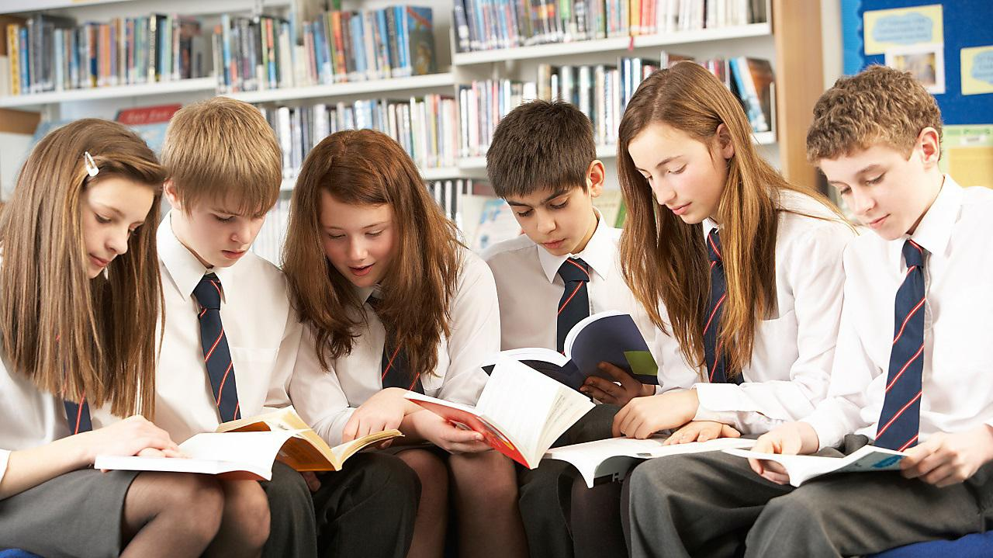

EDUCATION :
Pre-school
Primary School
Secondary School
Thertiory education
The system of education in Ireland is divided into :

Slide 7
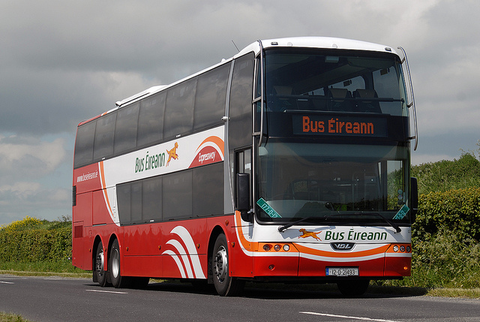
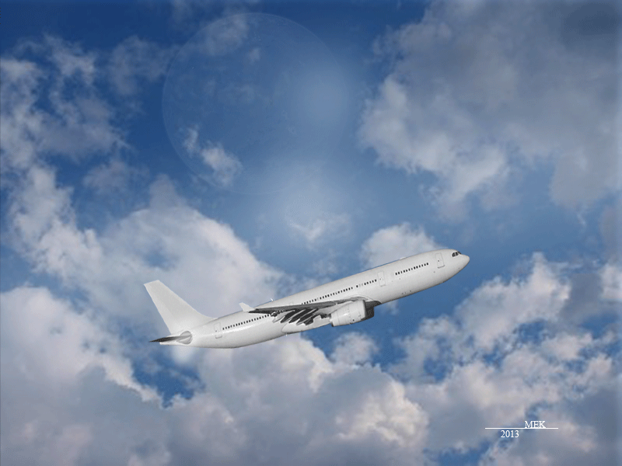
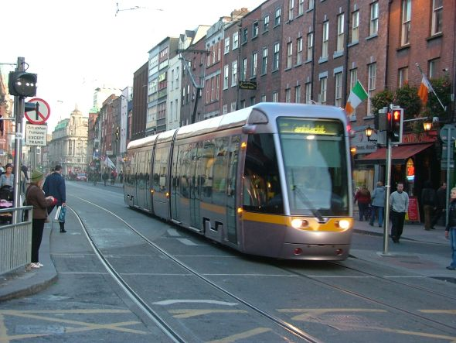
Public TRANSPORT :
In Ireland comfortable low-cost public transport is a bus. The main carrier in the country is Bus Eireann. There is also railway and tram in Ireland.
There is on airport and harbor in the City of Cork.

Slide 8
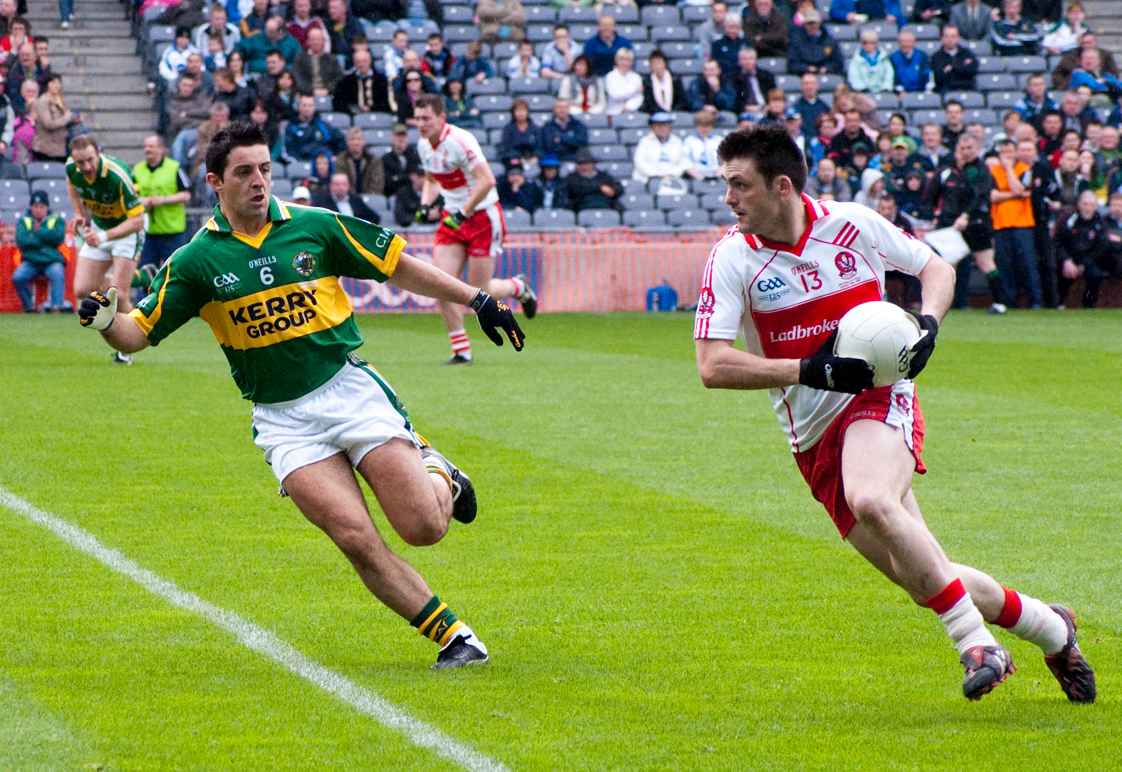
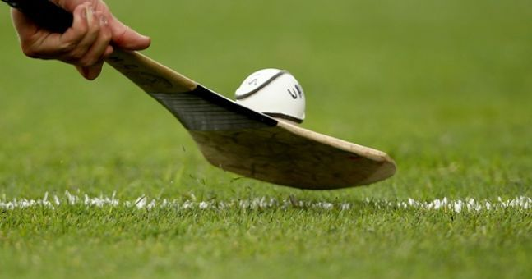
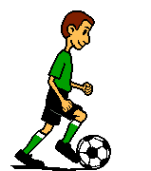
Sport :
HURLING- It is a team game in which players use sticks and balls. This game is one of the fastest sports in the world. It is considered to be the national sport of Ireland and it’s very popular.
GAELIC FOOTBALL - a team sport, one of the Irish team sports.

Slide 9
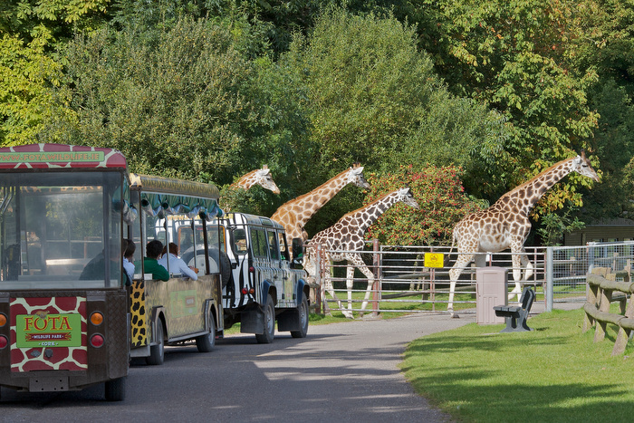
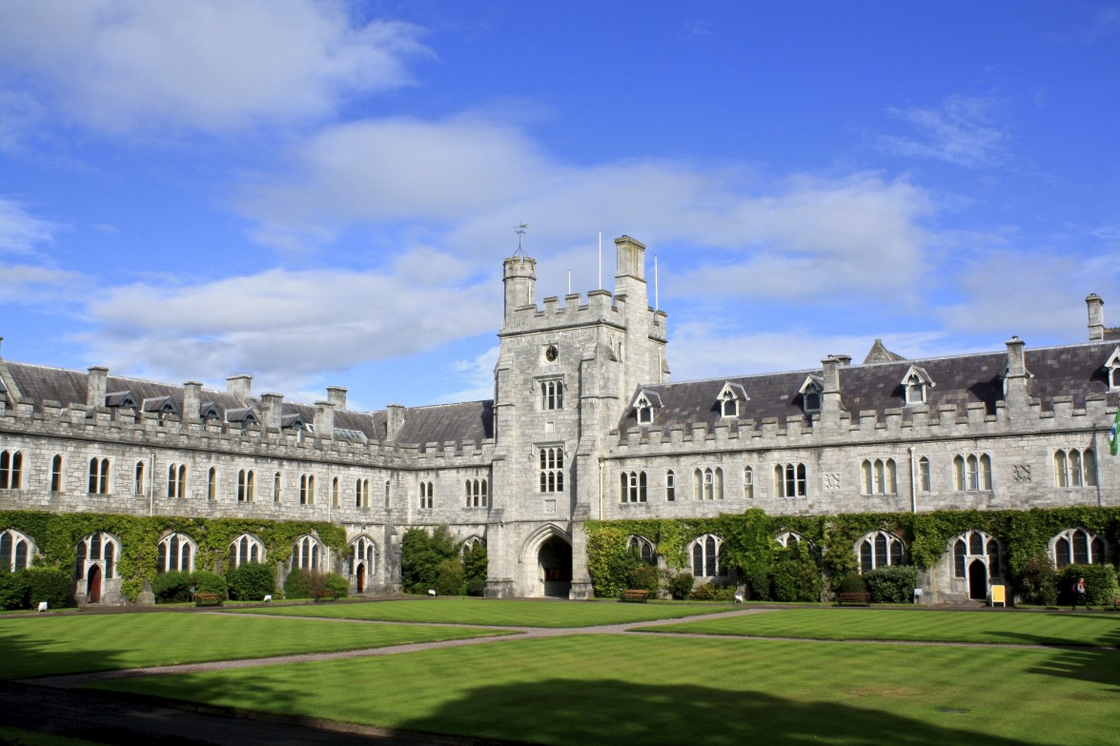
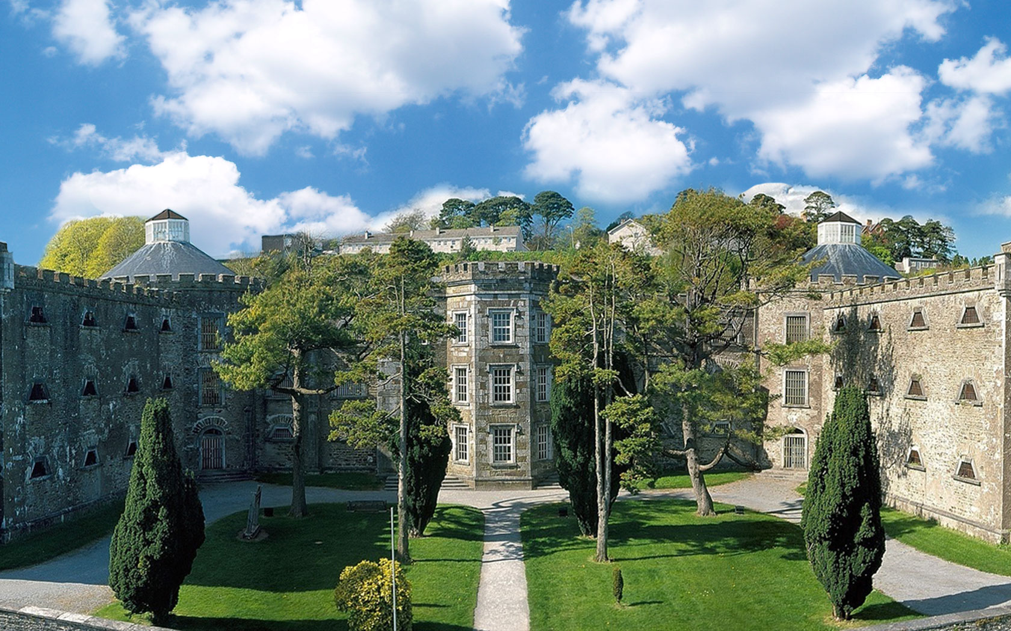
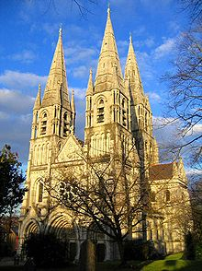
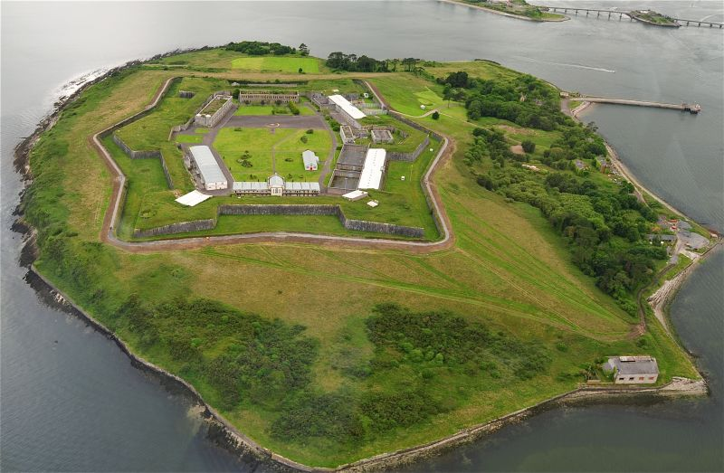
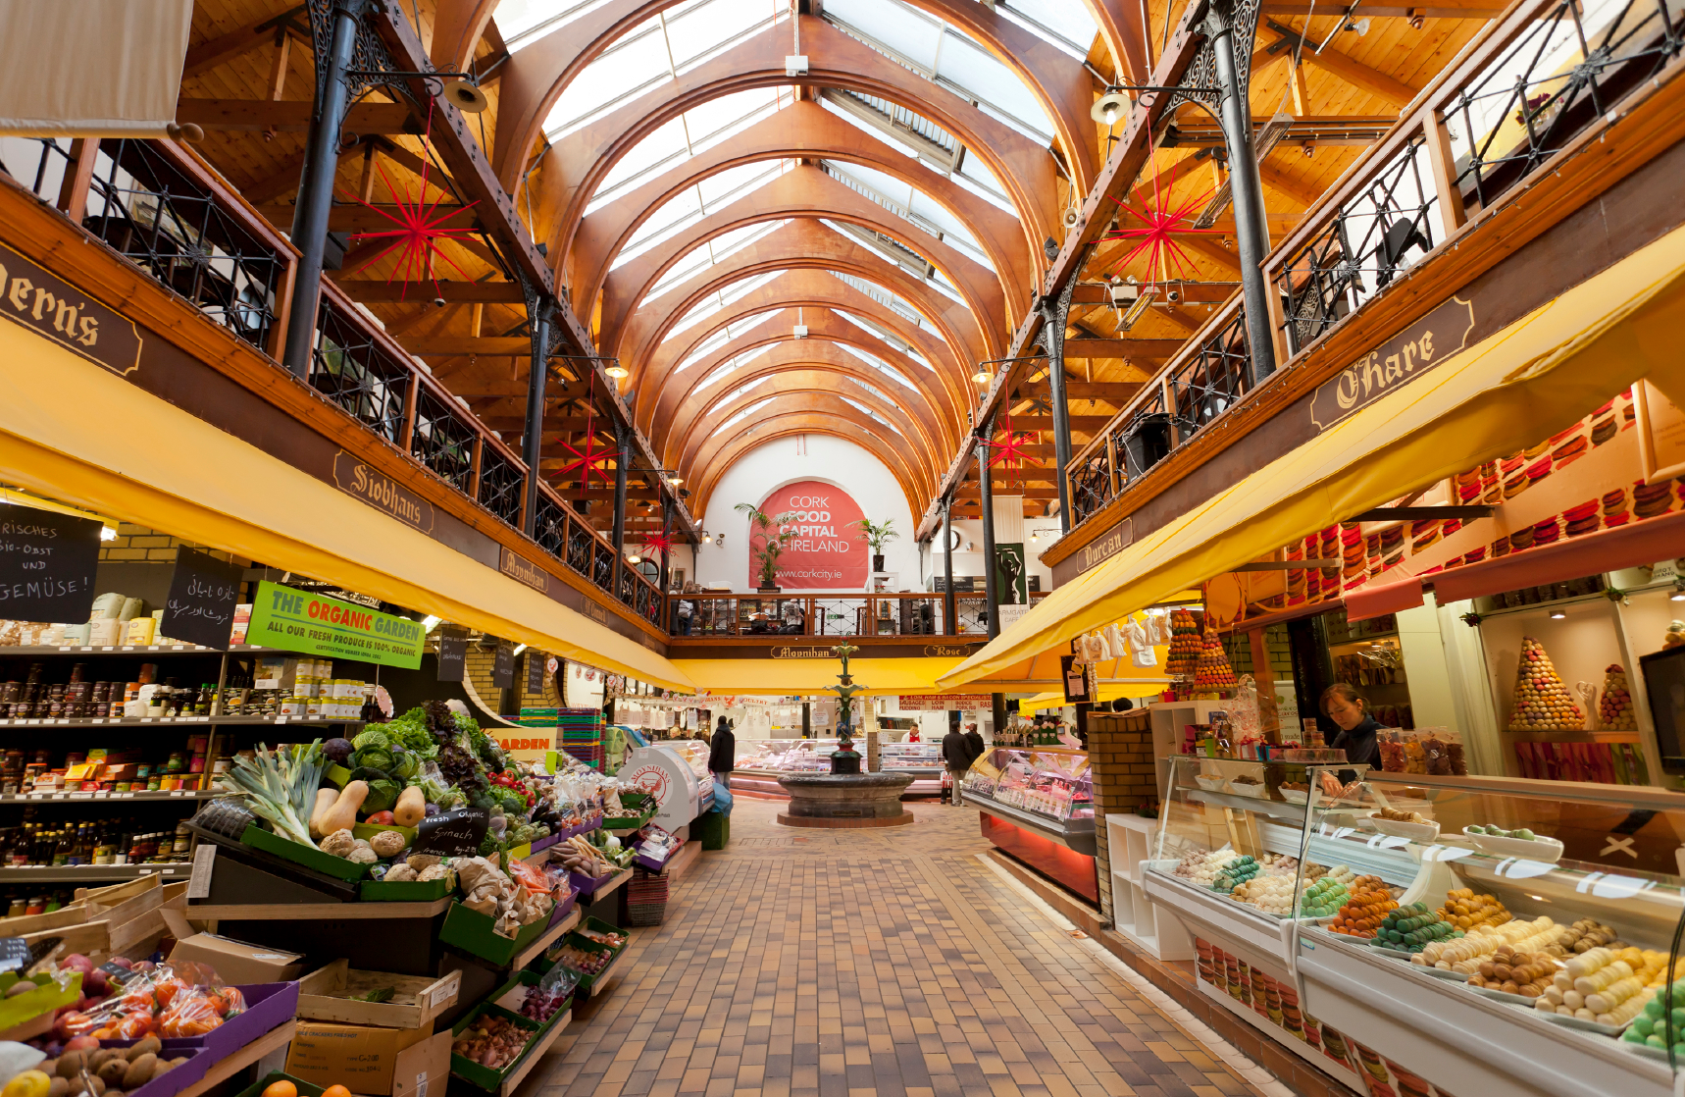
Ways of spending free time :
What to see in your free time in Ireland ?
Fota Wildlife Park
University College Cork
Cork City Gaol
St Fin Barre's Cathedral
Old English Market/City Market
Spike Island

Slide 10
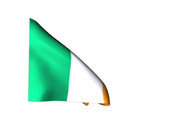
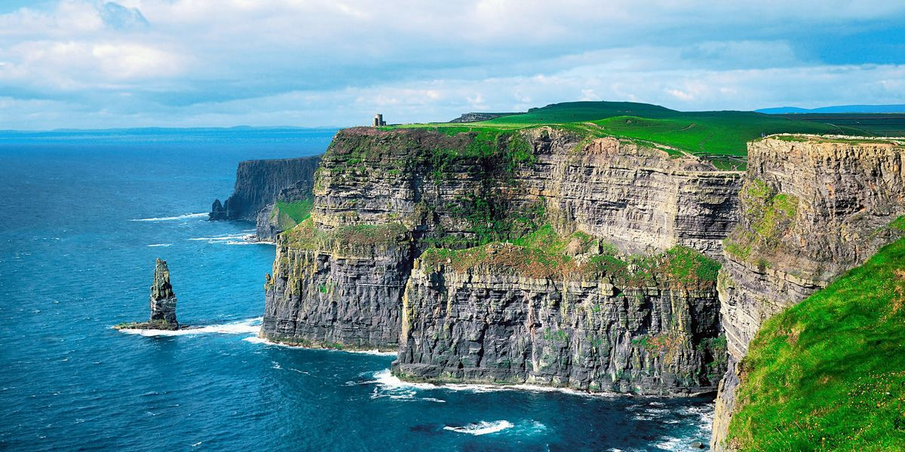
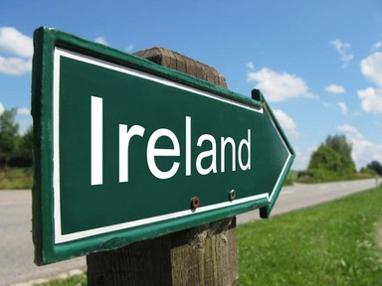
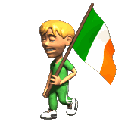
THE END
THANK YOU FOR YOUR ATTENTION

